Slide 1
Agriculture’s Economic Contribution to Rwanda (2000–2020)
This analysis explores Rwanda's agricultural GDP trends over the last two decades, providing context for decision-making.
Data Analysis & Dashboard Insights
Rutayisire Tevin | Date | Organization

Slide 2
Key Terms in the Title
GDP (Gross Domestic Product): Total value of goods and services produced within a country's borders during a specific period. It measures the economic performance of a nation.
Agriculture Value Added: The net output of the agricultural sector after adding up all outputs and subtracting intermediate inputs. It includes farming, livestock, forestry, and fishing.
Economic Contribution: The share or role of a sector (e.g., agriculture) in the overall GDP.
These definitions provide a foundation for understanding the data and insights in this presentation.

Slide 3
Purpose of the Analysis
This is a sourced and cleaned historical agricultural GDP data to ensure accuracy for visualization and prediction models.
Analyze historical agriculture value added in Rwanda’s GDP: This means looking at how much agriculture has contributed to Rwanda’s economy over the years.
Compare actual vs predicted contributions over time: Here, we compare real recorded figures with model-generated predictions for agriculture’s GDP share. This helps assess the accuracy of forecasting methods and identify any unusual changes or gaps.
Provide insights for strategic planning and investment decisions. The goal is to use the analysis to guide policymakers, investors, and stakeholders. Clear insights can help determine where to allocate resources, improve productivity, and sustain growth in the agricultural sector.

Slide 4
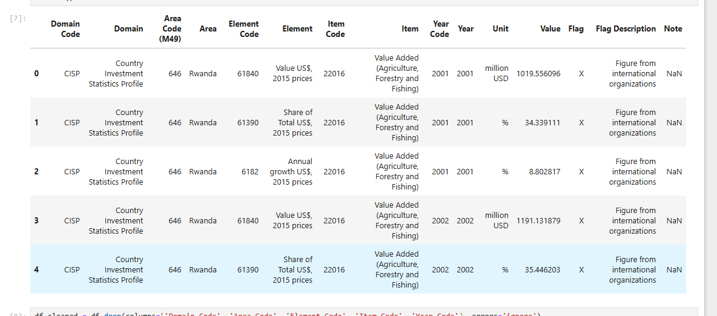
Data Sources & Preparation
The dashboard presents interactive visualizations that highlight key agricultural performance metrics.
rwanda_agriculture_value_added.csv — Historical and predicted values (2000–2020).
model_metrics.csv — Model accuracy metrics (R², RMSE).
Data prepared and visualized in Jupyter Notebook and Power BI.

Slide 5
Power BI Dashboard Pages
This section compares real and predicted agricultural GDP values, showing accuracy and consistency over time.
Page 1: Overview — Actual vs Predicted.
Page 2: Yearly Breakdown & Trends.
Page 3: Strategic Insights & Recommendations.
The annual trends chart shows how agriculture’s value added to Rwanda’s GDP changes year by year. This information helps in understanding the sector’s resilience to economic changes and external factors such as climate events and market prices. It also supports future planning by highlighting which years performed above or below expectations. The following are the predicted values of GDP over the previous years.

Slide 6
Page 1: Agriculture Value Added — Actual vs Predicted
Annual trends help identify strong and weak years, guiding planning for future agricultural growth.
Line Chart: Actual vs Predicted (2000–2020).
This comparison shows the actual recorded contribution of agriculture to Rwanda’s GDP alongside the predicted values from our model. The close alignment between the two lines indicates high prediction accuracy, suggesting the model is reliable for forecasting future trends. This view helps in validating our analysis and building confidence in using projections for planning and policy decisions.
Insight Box: Agriculture consistently contributes millions USD to GDP with high prediction accuracy.

Slide 7
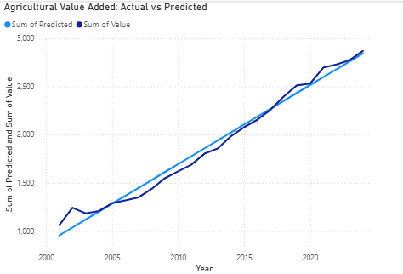
Line Chart.

Slide 8
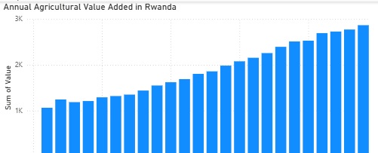
Page 2: Annual Trends
Key recommendations are derived from observed trends to inform government and investor strategies.
Column Chart: Year-by-Year Actual Value.
Line Chart: Predicted Growth Trend.
Optional Table: Year, Value, Predicted side-by-side.
The column chart shows the actual yearly value of agriculture’s contribution to Rwanda’s GDP. Each bar represents a single year, making it easy to see increases, decreases, and stable periods over time. This visual helps identify patterns, strong growth years, and times when the sector faced challenges.

Slide 9
Page 3: Insights & Recommendations
Overall findings confirm agriculture's role as a critical pillar of Rwanda's economy, with stable and predictable growth.
Agriculture, forestry, and fishing steadily growing.
Use projections to guide rural farming investments.
Maintain sector funding to sustain economic growth.
For More Information
Visit MINAGRI for Rwanda’s agriculture strategies.
Consult NISR for official sector statistics.
Use FAO and World Bank reports for global and comparative insights.

Slide 10
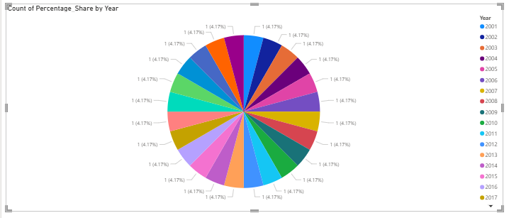
Conclusion
Future improvements could deepen analysis and integrate live data for continuous monitoring.
Agriculture remains a stable and vital GDP contributor.
Predictions align closely with historical data (R² = 0.89).
Dashboard provides a decision-support tool for policymakers.
This chart shows the share of agriculture value added to Rwanda's GDP across 2000–2020. It highlights consistent economic contributions and periods of stronger growth.

Slide 11
Future Improvements
The discussion section encourages audience participation to refine strategies and share insights.
Include comparison with other economic sectors.
Integrate real-time data feeds into Power BI.
Expand analysis to regional agricultural breakdowns.
While the current dashboard provides strong insights into agriculture’s contribution to Rwanda’s economy, future improvements could make it a real-time, interactive decision-support tool. Integrating sector comparisons, regional analysis, and climate impacts would provide policymakers with a deeper, more actionable understanding of the sector’s performance and future opportunities.

